Slide 1
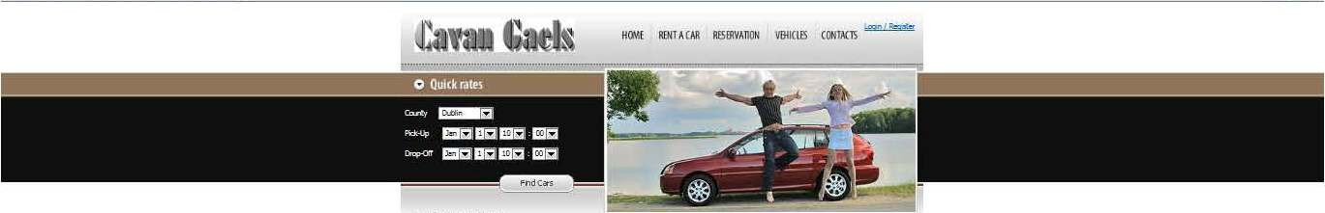
Presenters
CAR RENTAL WEBSITE
CAVAN GAELS
Brian Burns - x10205284
Sean O’Shea - x10206230
Torsby Attipoe - x11106409

Slide 2
Areas of Presentation
Requirements capture
Design
Development
Testing

Slide 3
Requirements capture
The purpose of the application is the provision of a web based Car Rental System . The application allows the user to:
User can search and book car for varying periods from different locations throughout the country.
View total cost of booking and pay
Users, suppliers can register details
Users, suppliers can log in and log out
The application also allows owners of fleets of cars to register their details, upload fleets of cars available for hire, change cars available for hire.

Slide 4
Design
Model
View
Controller
Business Logic Layer
The Data Access Layer

Slide 5
Development
Development environment used is the .NET framework, Microsoft integrated development environment Visual Studio Architectural pattern used is MVC4
API is REST

Slide 6
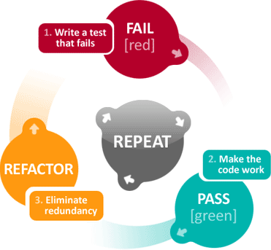
Testing
Test approach was based on unit testing methodology in a test driven development environment

